Slide 1


Slide 2

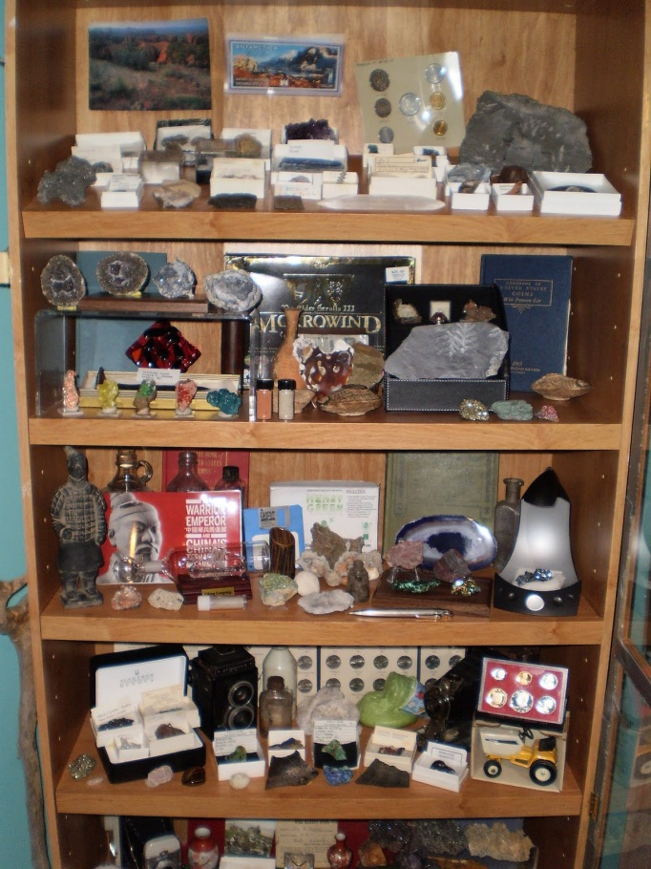
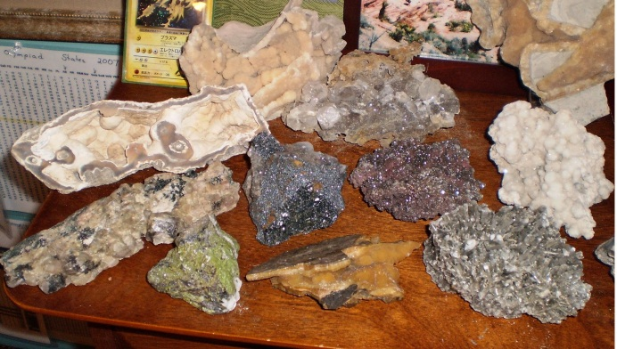
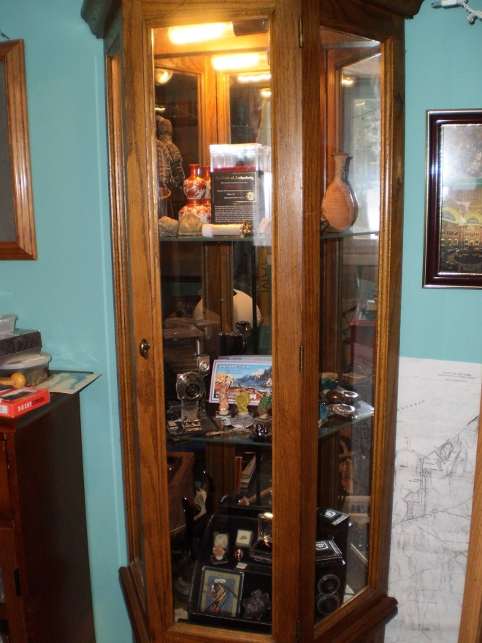
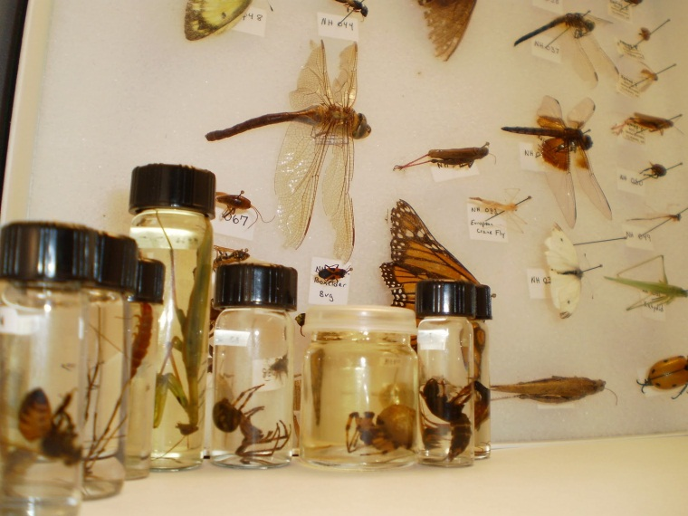

Slide 3

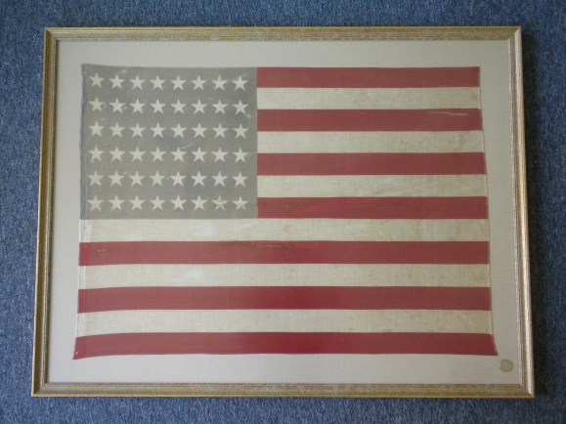
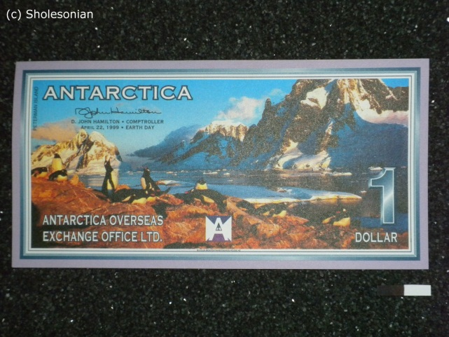
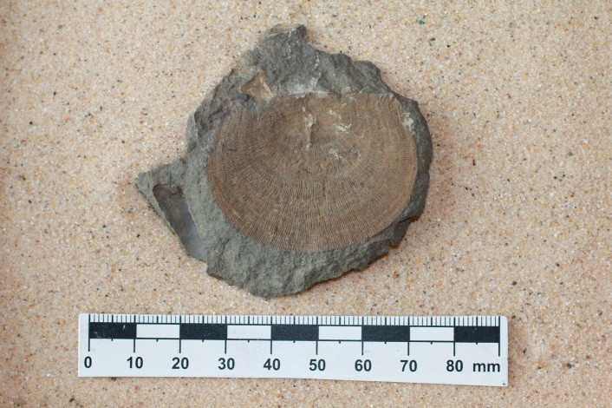
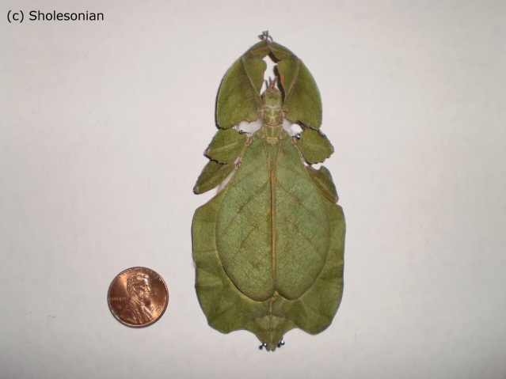
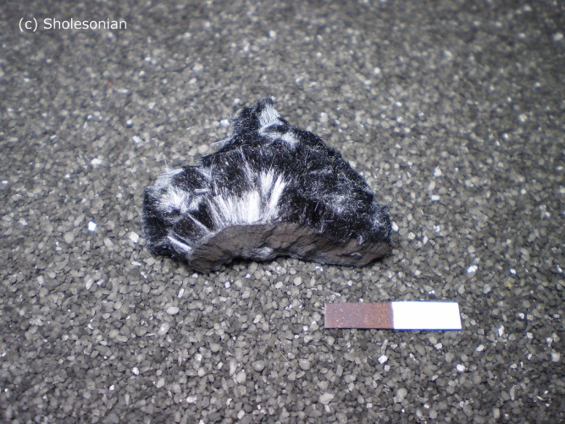
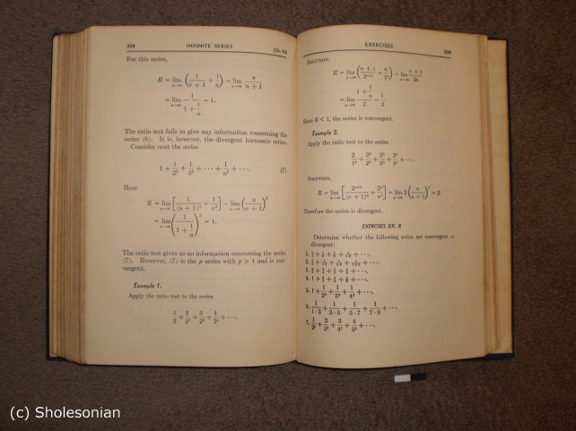

Slide 4

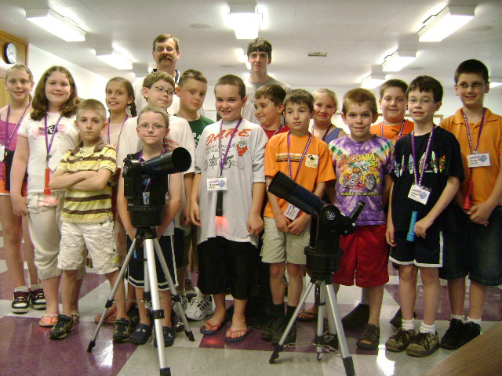
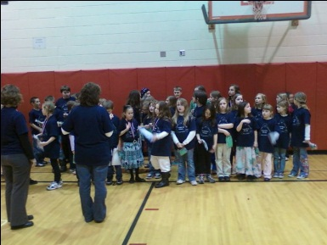
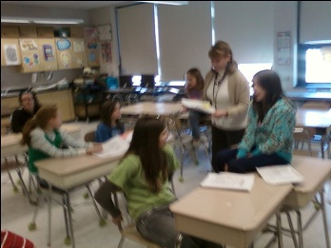
Outreach
Beyond the Web
Reach for the Stars
3rd + 5th Grade Talks
Science Olympiad
Inventive Minds

Slide 5

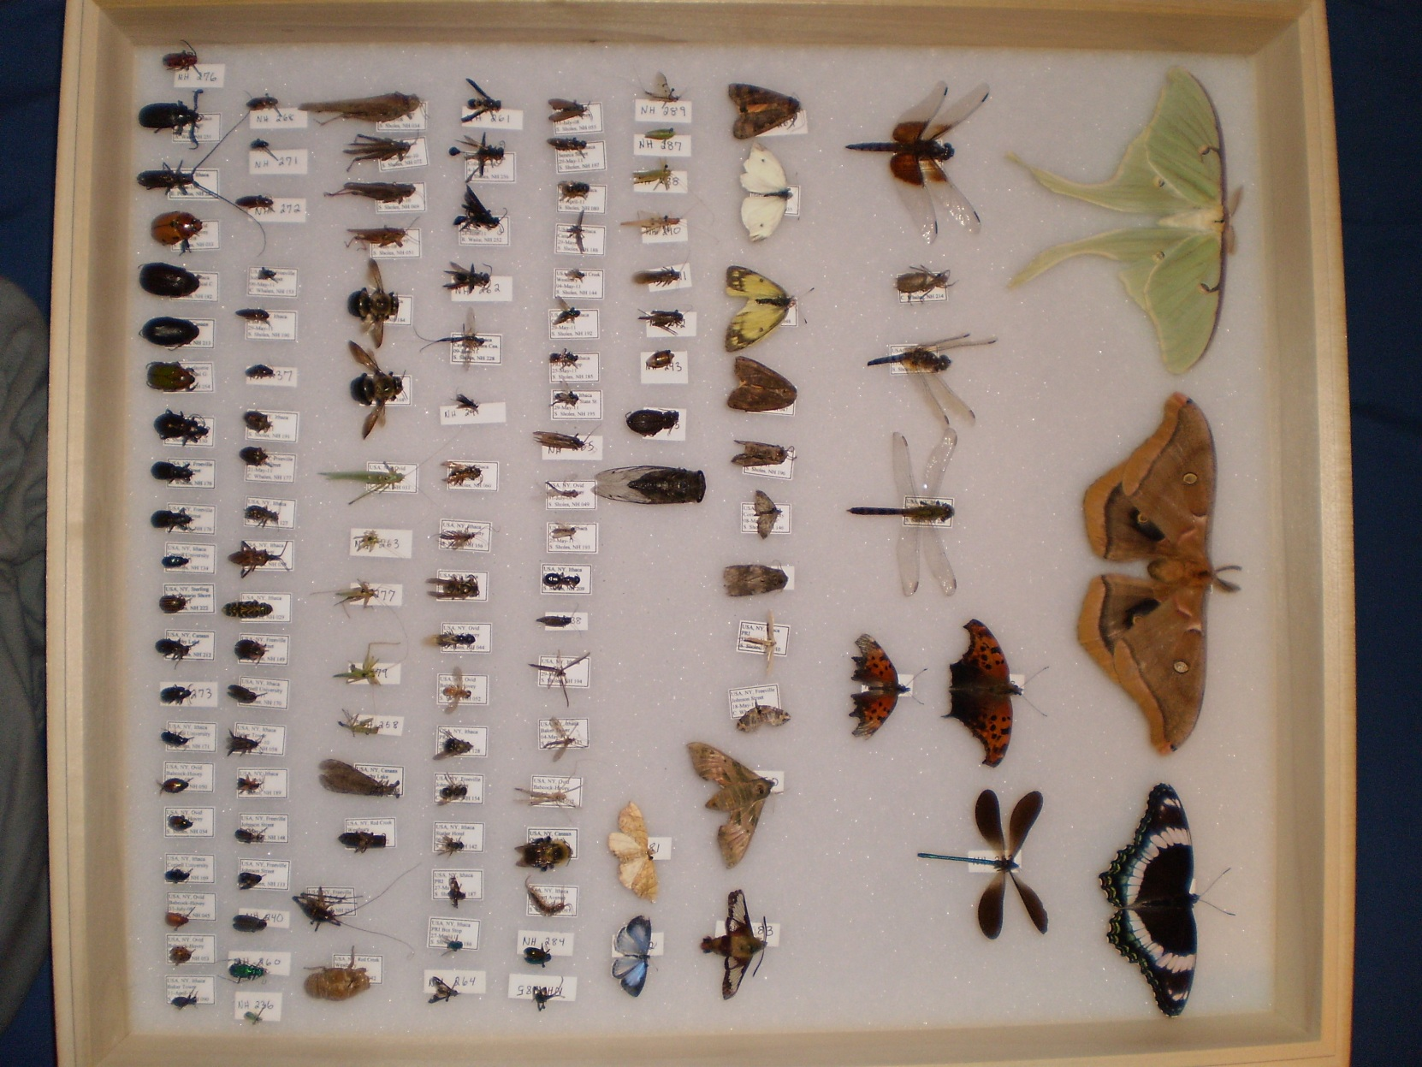
Entomology Collection

Slide 6
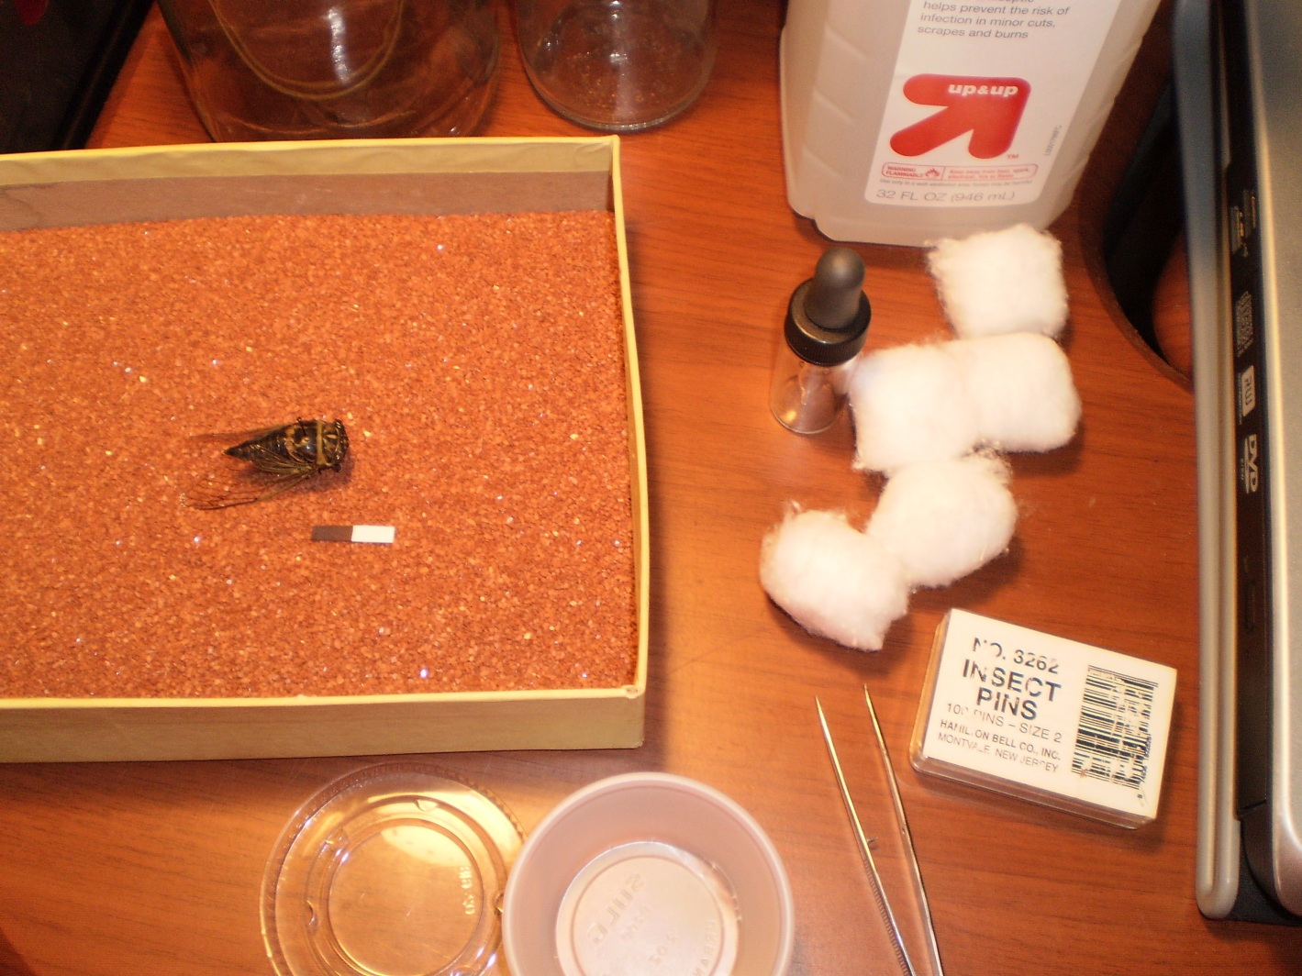
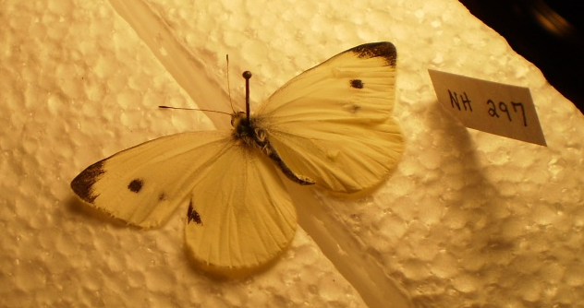
Pinning and Preserving Specimens
Use cotton balls or tissues with alcohol
Capture in jars or cups with lids
Carefully pin insects
Use pinning board or styrofoam for Lepidoptera
Use glass vials with tops for non-pinned insects
Place label on pin or on vial

Slide 7
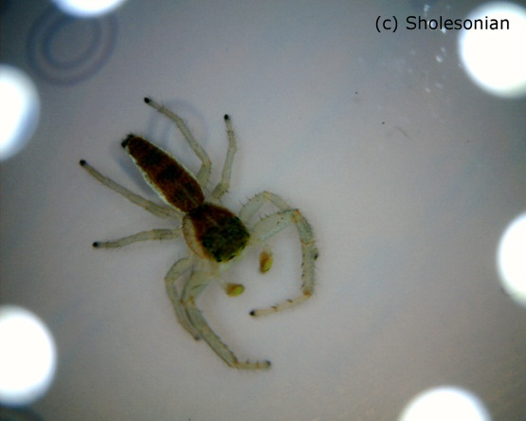
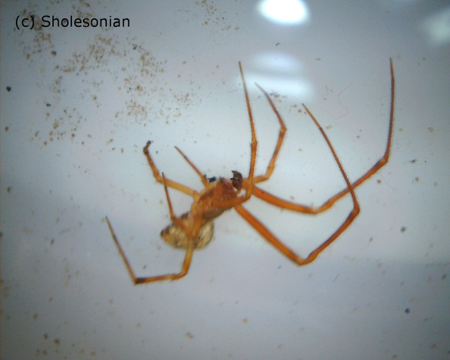
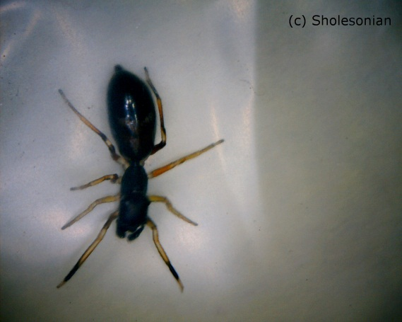
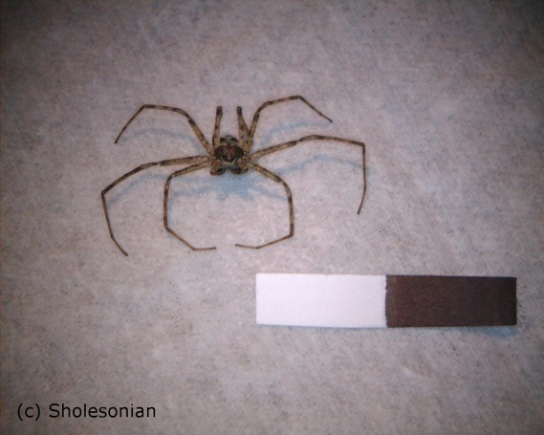
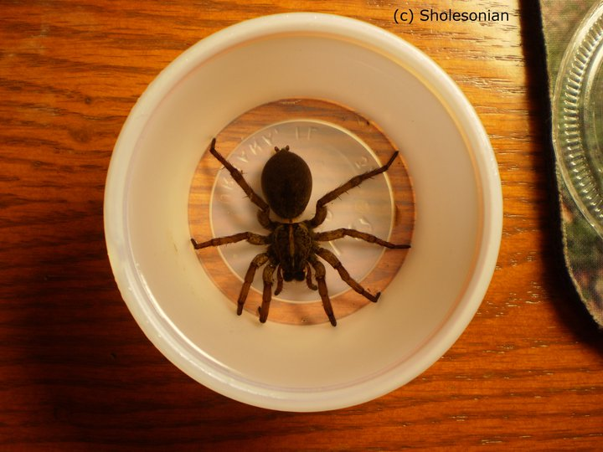
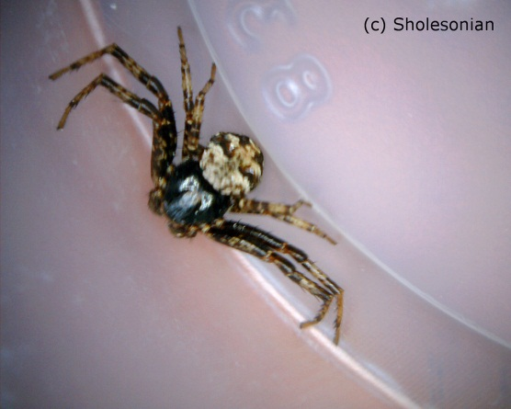
Spider Preservation
As with many other insects, spiders do not pin well
and thus need to be preserved in alcohol.
In a sealed container, use
Isopropyl alcohol (~70-90%)
Fill up lost liquid every
6 months or so
Label each vial
Specialty Bottle

Slide 8
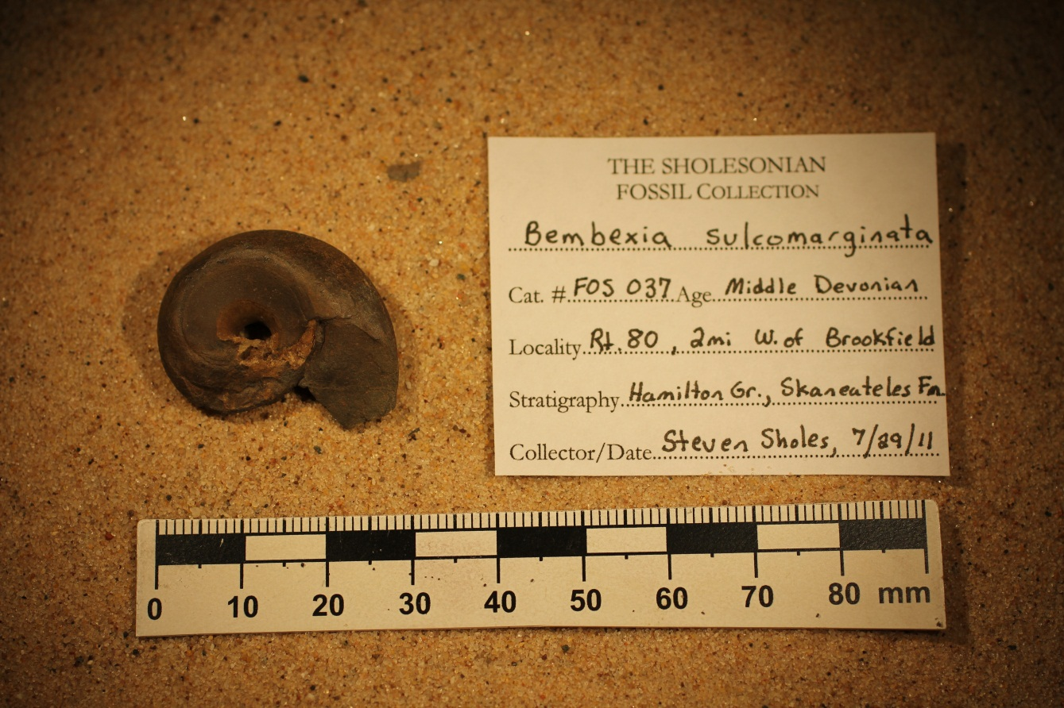
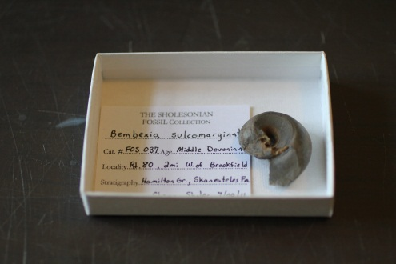
Storing The Collection
Location, Location, Location!
Write up a label, with location, give it a unique number
In a separate notebook, write down the same info.
Use jewelry boxes, etc.
Store in drawers and/or box tops

Slide 9
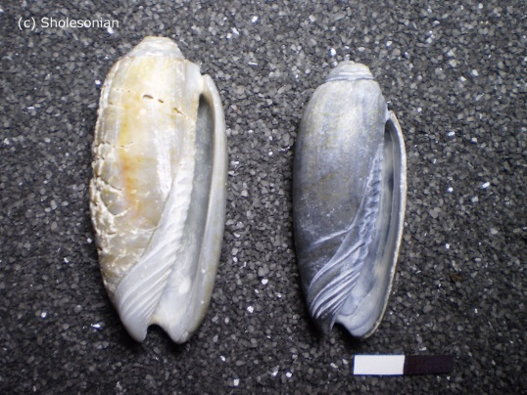
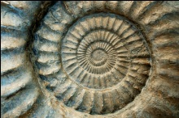
How To ID?
Insects and Spiders
Rocks & Minerals
BugGuide.net
SpiderIdentification.org
InsectIdentification.org
CirrusImage.com/Beetles.htm
ButterfliesAndMoths.org
MinDat.org
WebMineral.com
RockKey
Fossils
Karl Wilson’s NY Paleontology

Slide 10




Find Us!
And Get Involved!
Sholesonian.Blogspot.com
This Presentation Will Be Posted On The Blog

